Slide 1

Click Prediction
Keivan Mokhtarpour

Slide 2


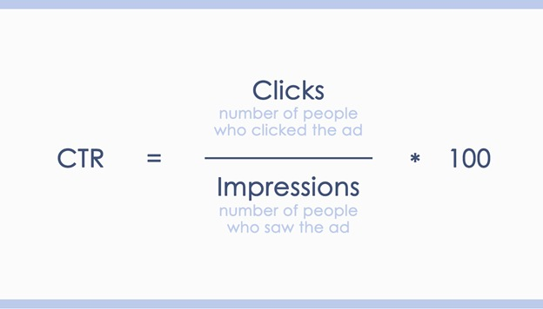
Mobile Payment Aggregator

Slide 3

Data Model
transactions
impressions
clicks

Slide 4
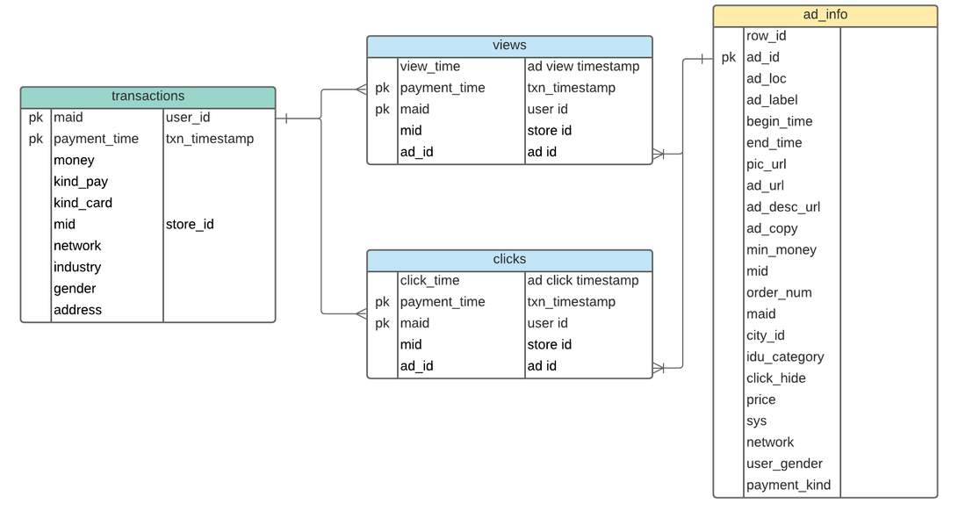
Data Model

Slide 5
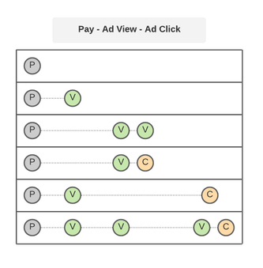
Click Scenarios
Payment time
Last view time
Number of views
Time interval between payment and the last view

Slide 6

Problem Solving Steps
Data Collection
Feature Engineering
Data Cleaning
Exploratory Data Analysis
Model Training

Slide 7
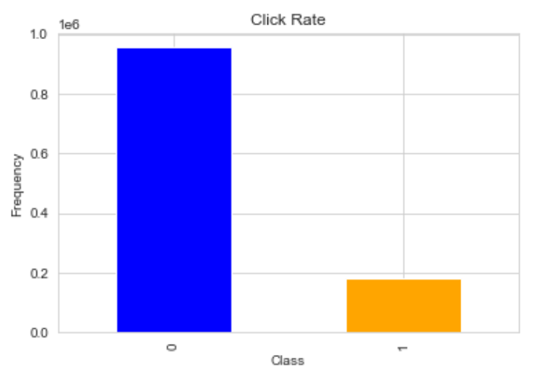
Data Collection
Surveyed Time: 08/01/2017
Transactions–based ( User ID + Payment Time )
DataFrame Size: 1134545 rows × 22 columns
Number of transactions not lead to click: 955829
Number of transactions lead to click: 178716
Percentage of clicked to non-clicked transactions: 5.35 %

Slide 8
Problem Solving Steps
Data Collection
Feature Engineering
Data Cleaning
Exploratory Data Analysis
Model Training

Slide 9
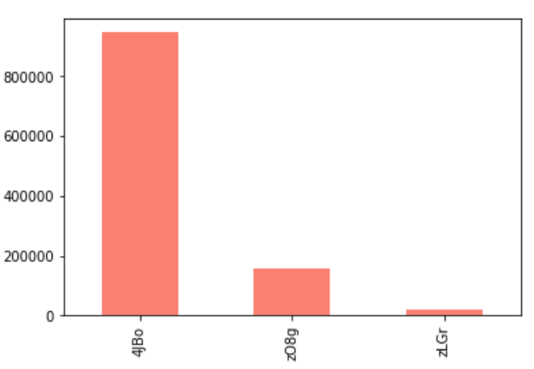
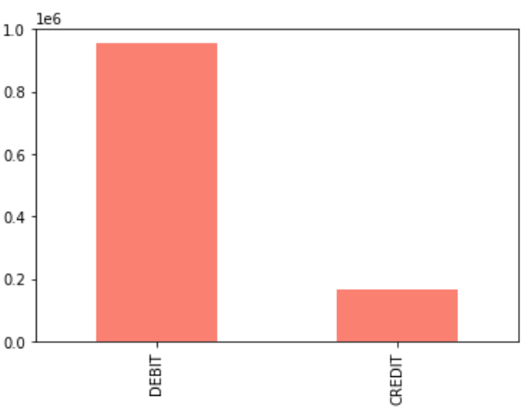
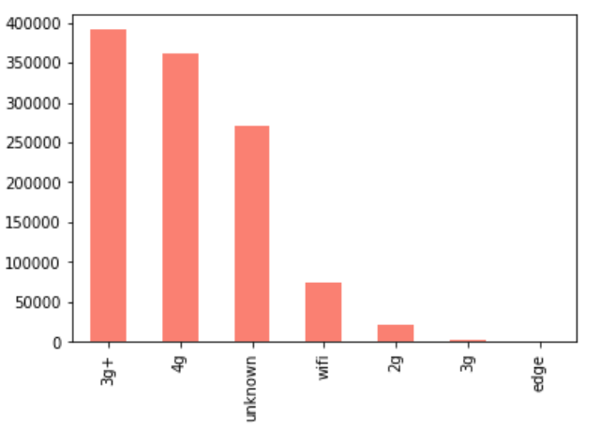
Exploratory Data Analysis
Kind_Pay
Kind_Card
Network

Slide 10
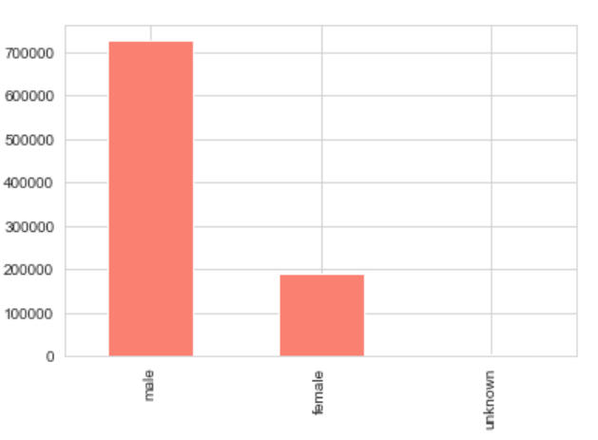
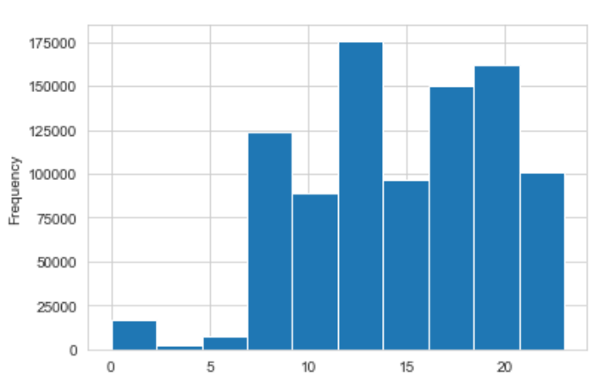
Exploratory Data Analysis
Gender
Payment & View Time
Daytime
Early Morning

Slide 11
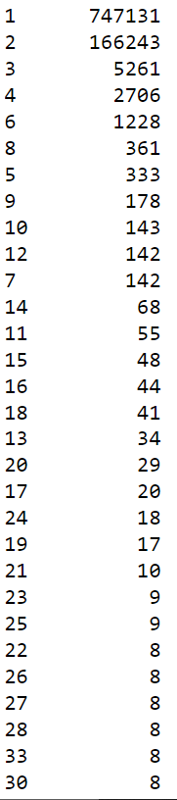
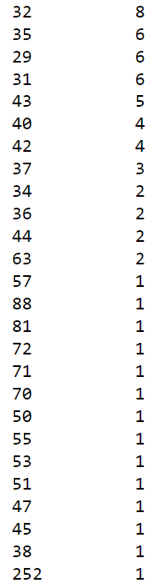
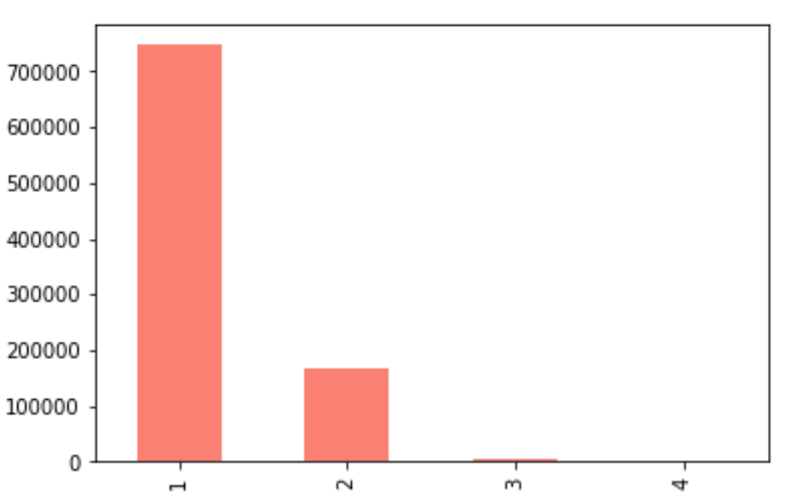
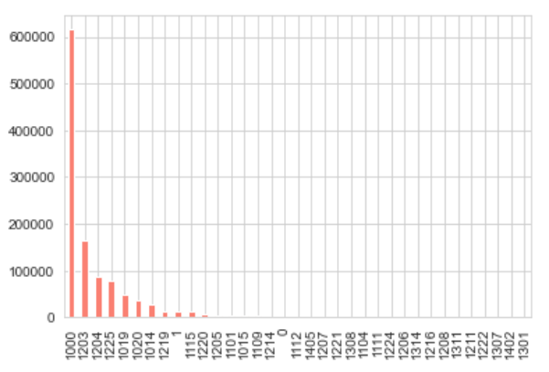
Exploratory Data Analysis
Views Count
Industry

Slide 12
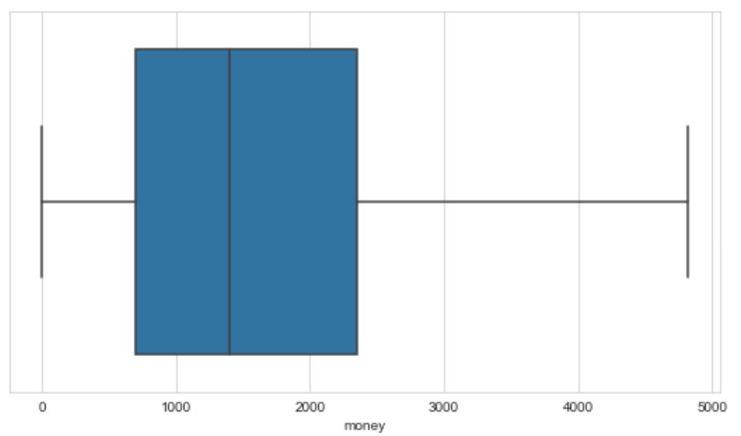
Exploratory Data Analysis
Money (Price)

Slide 13
Problem Solving Steps
Data Collection
Feature Engineering
Data Cleaning
Exploratory Data Analysis
Model Training

Slide 14

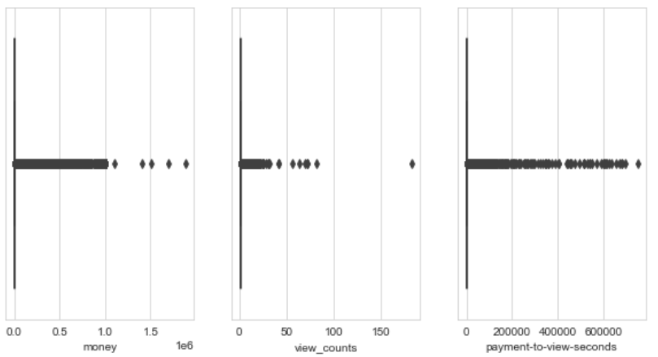
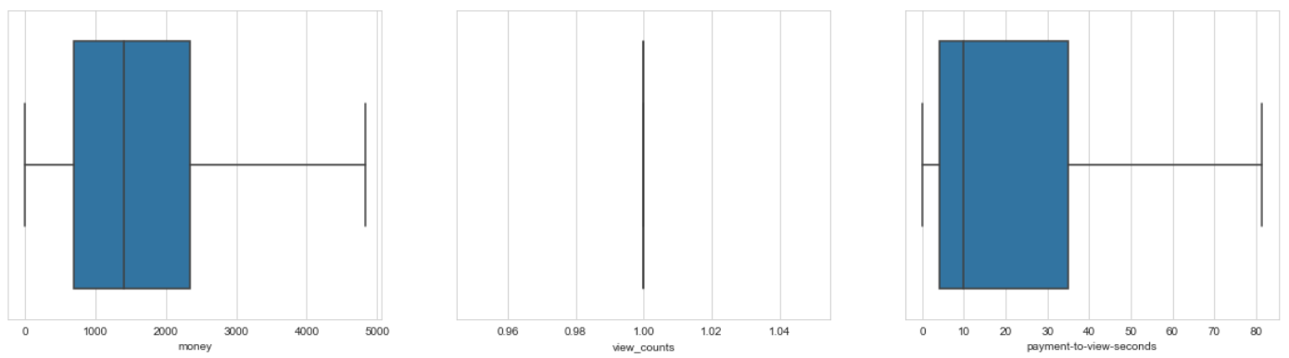
Major Changes
Removing Duplicate Records
Removing records for which view time is before the payment time.
Removing all impression related to a transaction except the last one.
Removing categorial columns with so many classes (like ‘industry’).
Removing irrelevant columns like user ID.
Renaming mistyped classes (unkonwn to unknown in column ‘sex’).
Setting Null values to appropriate classes (Null to unknown in ‘sex’).
Removing columns for which we have limited knowledge (address).
Handling outliers

Slide 15
Problem Solving Steps
Data Collection
Feature Engineering
Data Cleaning
Exploratory Data Analysis
Model Training

Slide 16
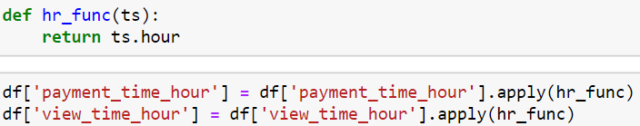
Feature Engineering
Payment and view time
Convert payment and view time to categorial (based on exploratory data analysis)
Payment to view time interval column
Number of Impressions (unique by user ID and payment time/ all impressions of a user)

Slide 17
Problem Solving Steps
Data Collection
Feature Engineering
Data Cleaning
Exploratory Data Analysis
Model Training

Slide 18
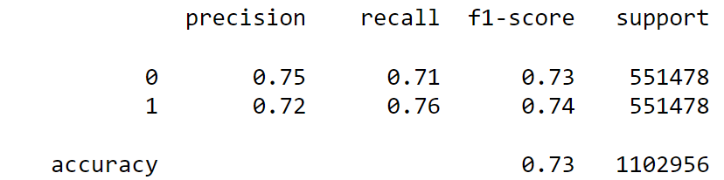
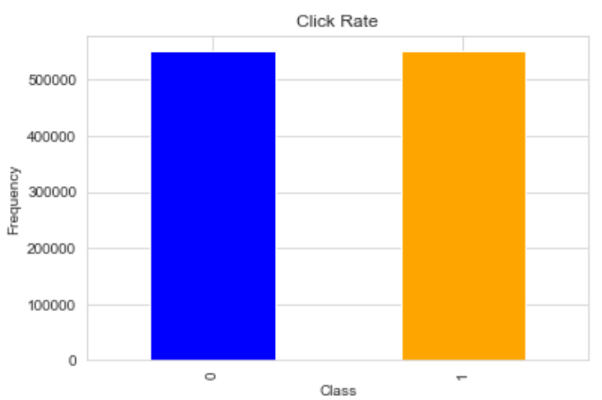
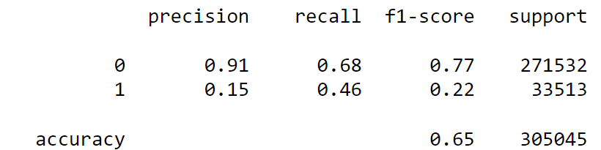
Model Training
OverSampling
5-fold cross validation with RandomForestClassifer
Train:
Test:

Slide 19
Thank You
keivan-mokhtarpour.github.io/

